Slide 1
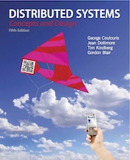
Slides for Chapter 21:
Designing Distributed Systems: Google Case Study
From Coulouris, Dollimore, Kindberg and Blair
Distributed Systems:
Concepts and Design
Edition 5, © Addison-Wesley 2012

Slide 2
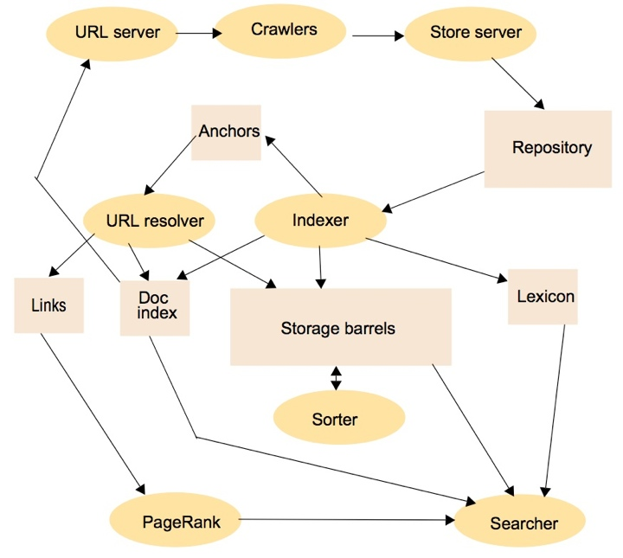
Figure 21.1
Outline architecture of the original Google search engine [Brin and Page 1998]
Instructor’s Guide for Coulouris, Dollimore, Kindberg and Blair, Distributed Systems: Concepts and Design Edn. 5
© Pearson Education 2012

Slide 3
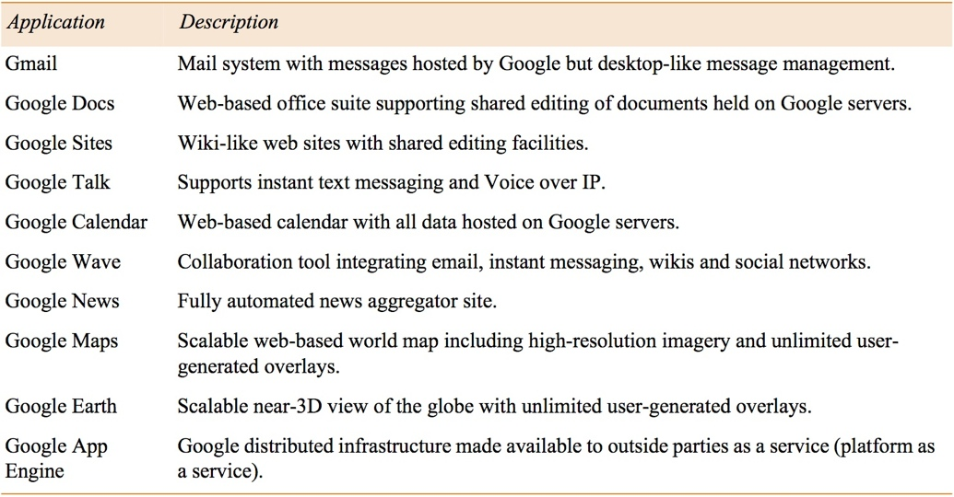
Figure 21.2
Example Google applications
Instructor’s Guide for Coulouris, Dollimore, Kindberg and Blair, Distributed Systems: Concepts and Design Edn. 5
© Pearson Education 2012

Slide 4
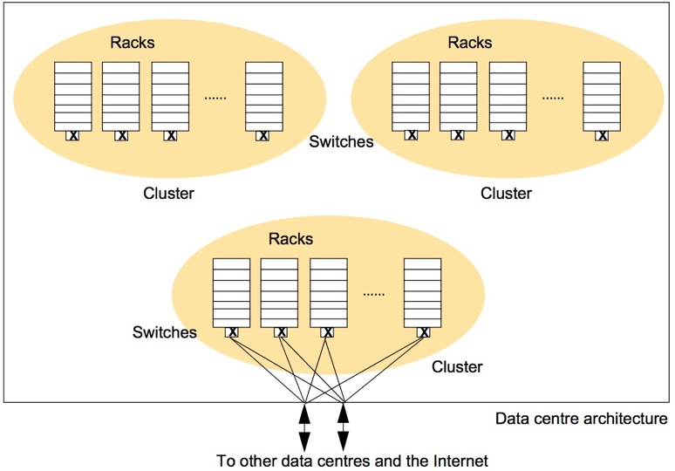
Figure 21.3
Organization of the Google physical infrastructure
(To avoid clutter the Ethernet connections are shown from only one of the clusters to the external links)
Instructor’s Guide for Coulouris, Dollimore, Kindberg and Blair, Distributed Systems: Concepts and Design Edn. 5
© Pearson Education 2012

Slide 5
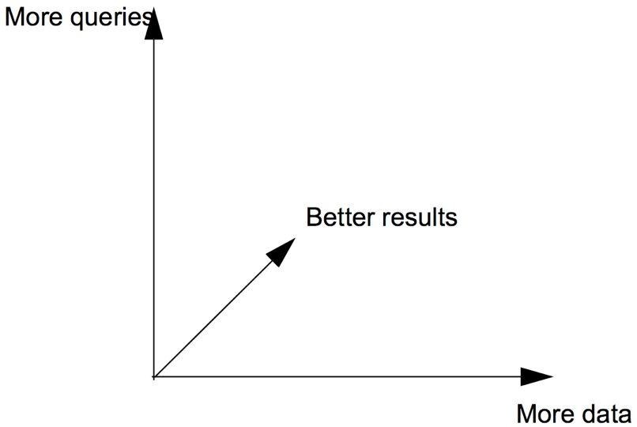
Figure 21.4
The scalability problem in Google
Instructor’s Guide for Coulouris, Dollimore, Kindberg and Blair, Distributed Systems: Concepts and Design Edn. 5
© Pearson Education 2012

Slide 6
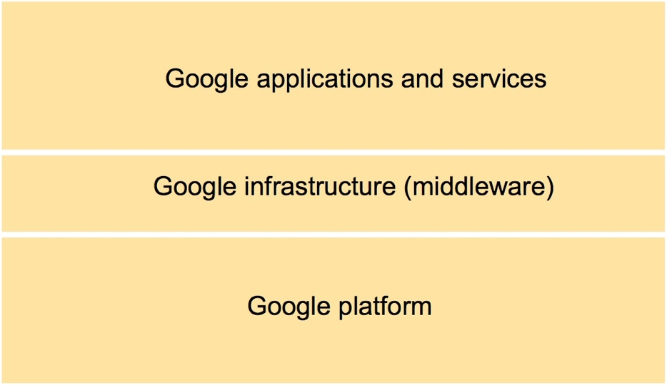
Figure 21.5
The overall Google systems architecture
Instructor’s Guide for Coulouris, Dollimore, Kindberg and Blair, Distributed Systems: Concepts and Design Edn. 5
© Pearson Education 2012

Slide 7
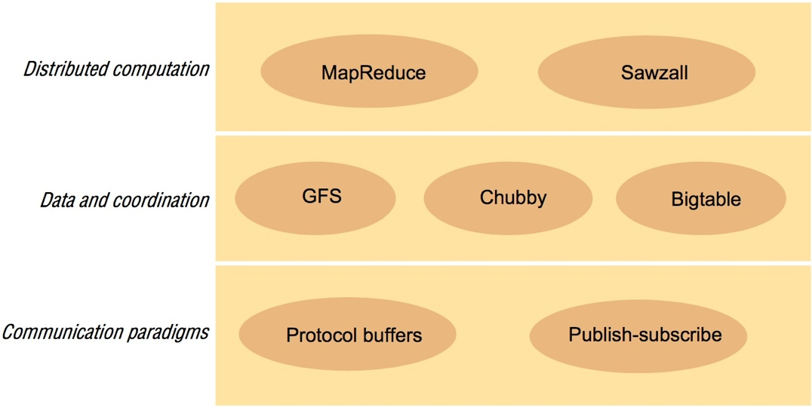
Figure 21.6
Google infrastructure
Instructor’s Guide for Coulouris, Dollimore, Kindberg and Blair, Distributed Systems: Concepts and Design Edn. 5
© Pearson Education 2012

Slide 8
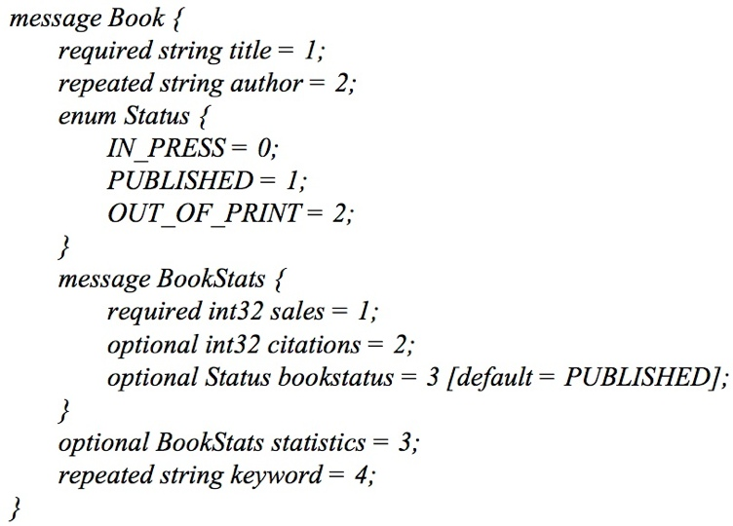
Figure 21.7
Protocol buffers example
Instructor’s Guide for Coulouris, Dollimore, Kindberg and Blair, Distributed Systems: Concepts and Design Edn. 5
© Pearson Education 2012

Slide 9
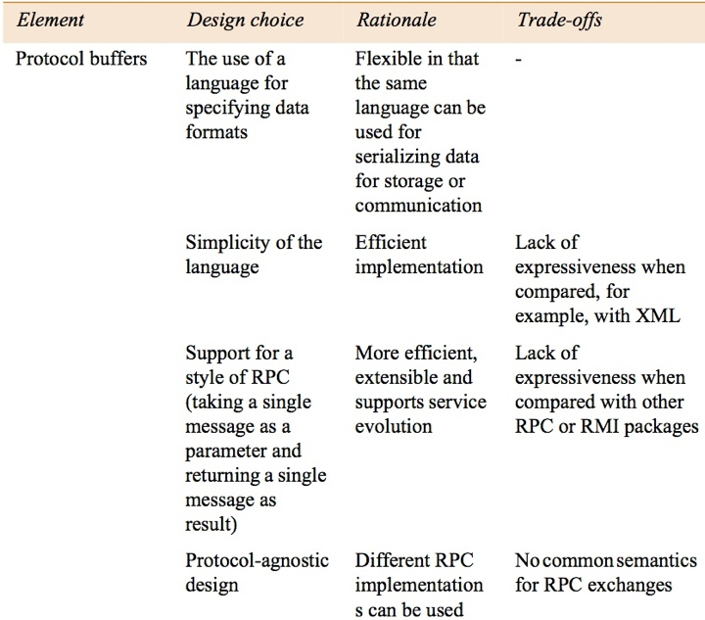
Figure 21.8a
Summary of design choices related to communication paradigms - part 1
Instructor’s Guide for Coulouris, Dollimore, Kindberg and Blair, Distributed Systems: Concepts and Design Edn. 5
© Pearson Education 2012

Slide 10
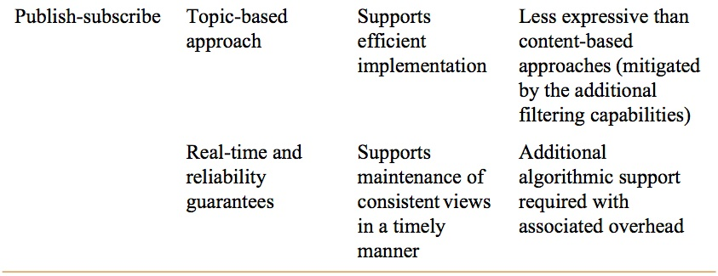
Figure 21.8b
Summary of design choices related to communication paradigms - part 2
Instructor’s Guide for Coulouris, Dollimore, Kindberg and Blair, Distributed Systems: Concepts and Design Edn. 5
© Pearson Education 2012

Slide 11
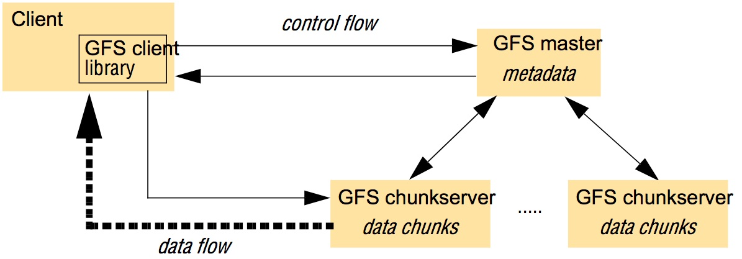
Figure 21.9
Overall architecture of GFS
Instructor’s Guide for Coulouris, Dollimore, Kindberg and Blair, Distributed Systems: Concepts and Design Edn. 5
© Pearson Education 2012

Slide 12
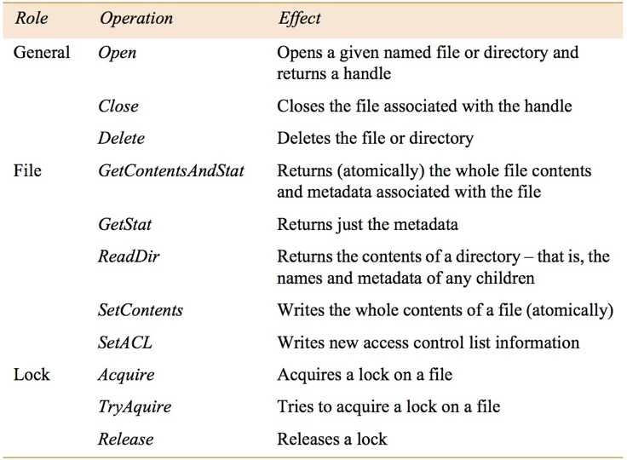
Figure 21.10
Chubby API
Instructor’s Guide for Coulouris, Dollimore, Kindberg and Blair, Distributed Systems: Concepts and Design Edn. 5
© Pearson Education 2012

Slide 13
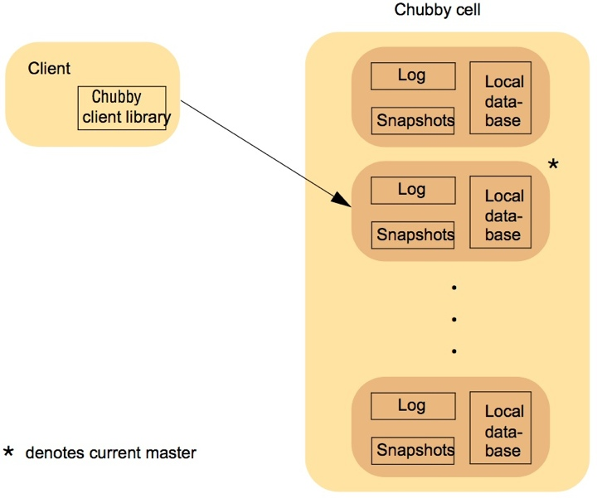
Figure 21.11
Overall architecture of Chubby
Instructor’s Guide for Coulouris, Dollimore, Kindberg and Blair, Distributed Systems: Concepts and Design Edn. 5
© Pearson Education 2012

Slide 14
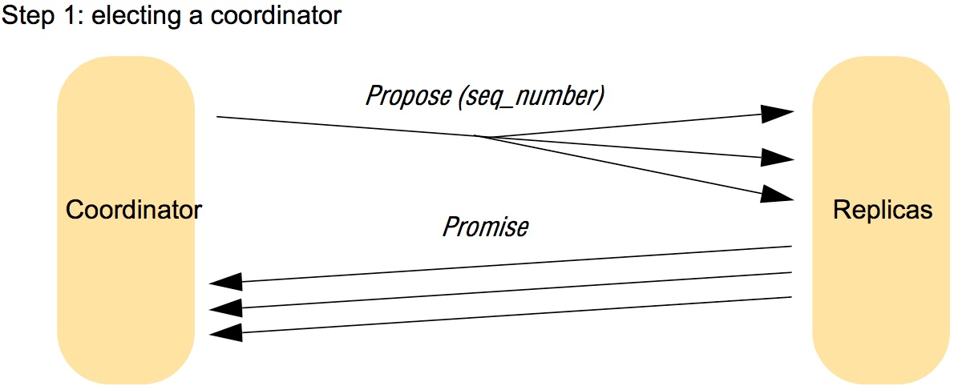
Figure 21.12
Message exchanges in Paxos (in absence of failures) - step 1
Instructor’s Guide for Coulouris, Dollimore, Kindberg and Blair, Distributed Systems: Concepts and Design Edn. 5
© Pearson Education 2012

Slide 15
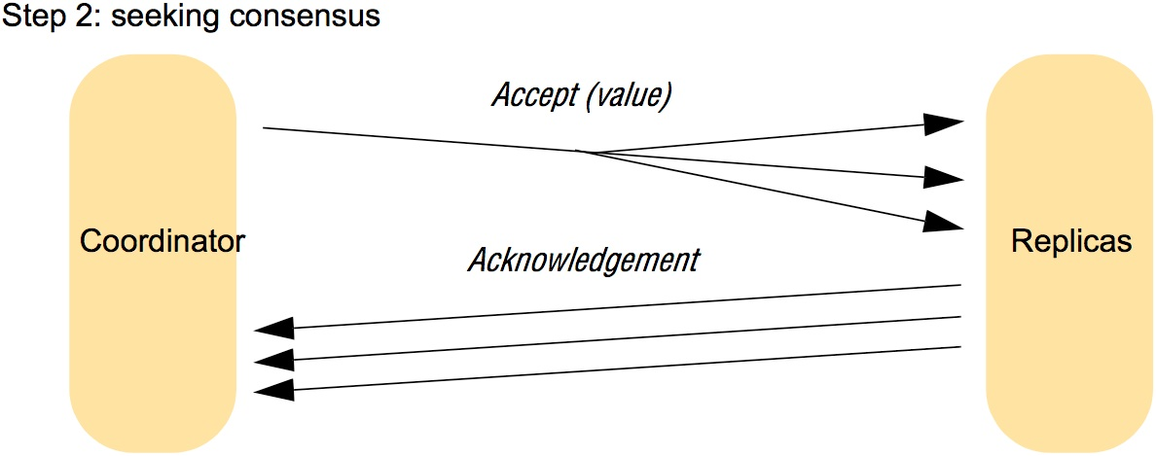
Figure 21.12
Message exchanges in Paxos (in absence of failures) - step 2
Instructor’s Guide for Coulouris, Dollimore, Kindberg and Blair, Distributed Systems: Concepts and Design Edn. 5
© Pearson Education 2012

Slide 16
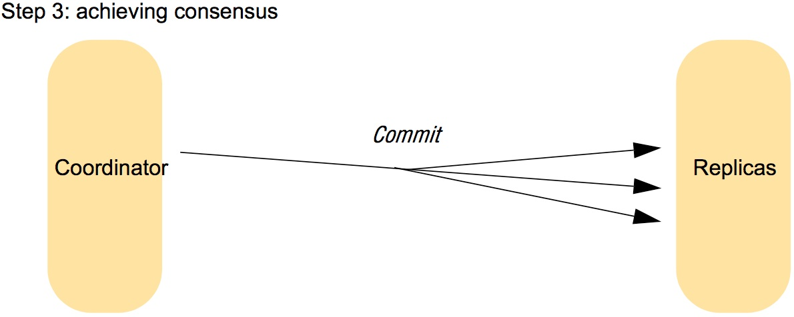
Figure 21.12
Message exchanges in Paxos (in absence of failures) - step 3
Instructor’s Guide for Coulouris, Dollimore, Kindberg and Blair, Distributed Systems: Concepts and Design Edn. 5
© Pearson Education 2012

Slide 17
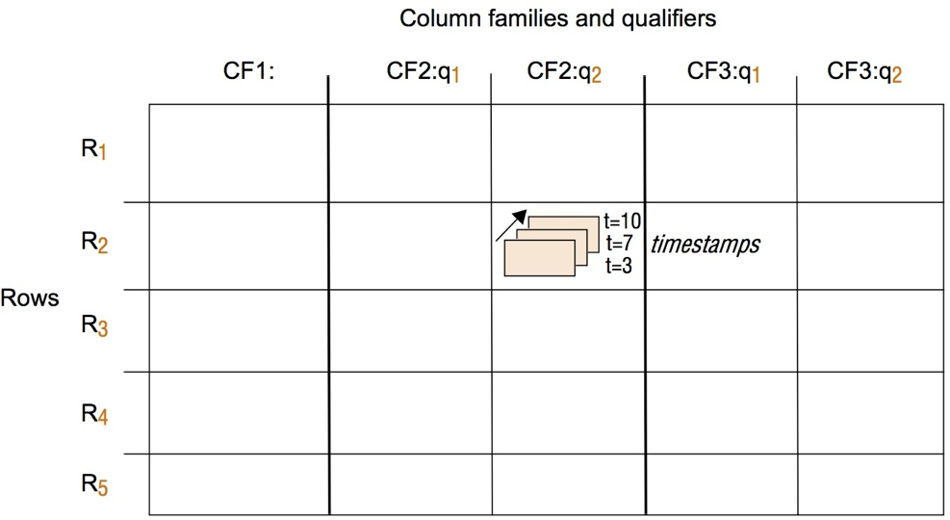
Figure 21.13
The table abstraction in Bigtable
Instructor’s Guide for Coulouris, Dollimore, Kindberg and Blair, Distributed Systems: Concepts and Design Edn. 5
© Pearson Education 2012

Slide 18
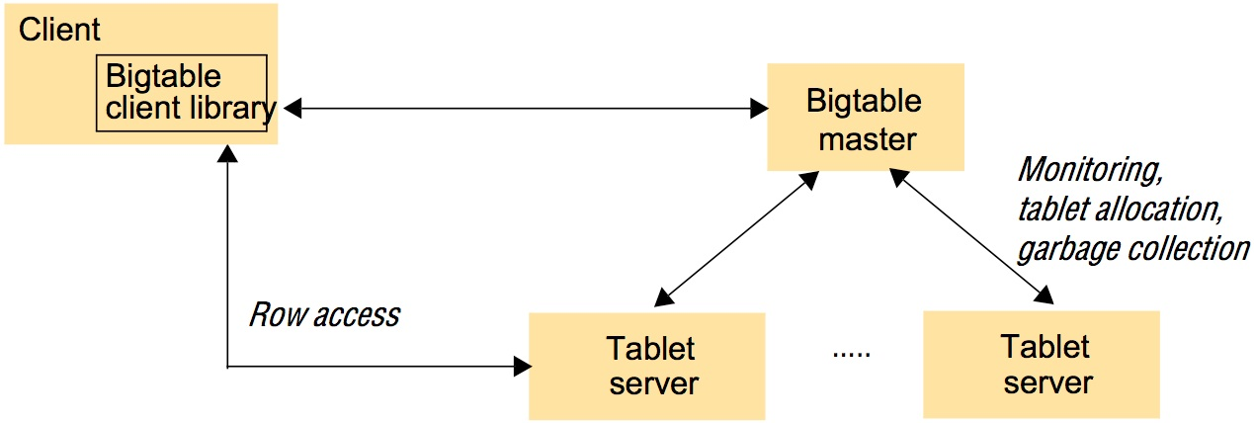
Figure 21.14
Overall architecture of Bigtable
Instructor’s Guide for Coulouris, Dollimore, Kindberg and Blair, Distributed Systems: Concepts and Design Edn. 5
© Pearson Education 2012

Slide 19
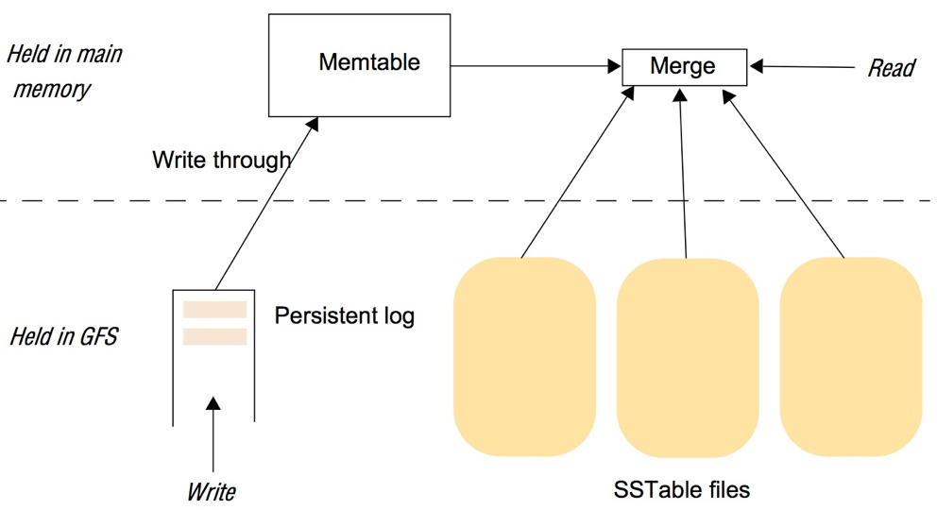
Figure 21.15
The storage architecture in Bigtable
Instructor’s Guide for Coulouris, Dollimore, Kindberg and Blair, Distributed Systems: Concepts and Design Edn. 5
© Pearson Education 2012

Slide 20
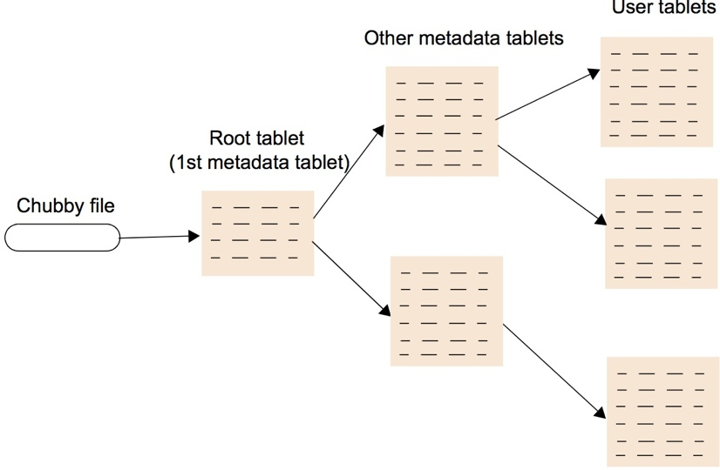
Figure 21.16
The hierarchical indexing scheme adopted by Bigtable
Instructor’s Guide for Coulouris, Dollimore, Kindberg and Blair, Distributed Systems: Concepts and Design Edn. 5
© Pearson Education 2012

Slide 21
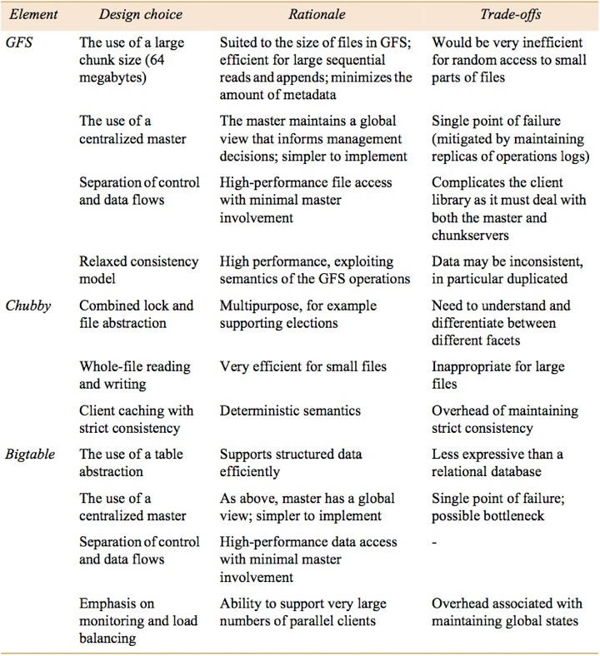
Figure 21.17
Summary of design choices related to data storage and coordination
Instructor’s Guide for Coulouris, Dollimore, Kindberg and Blair, Distributed Systems: Concepts and Design Edn. 5
© Pearson Education 2012

Slide 22
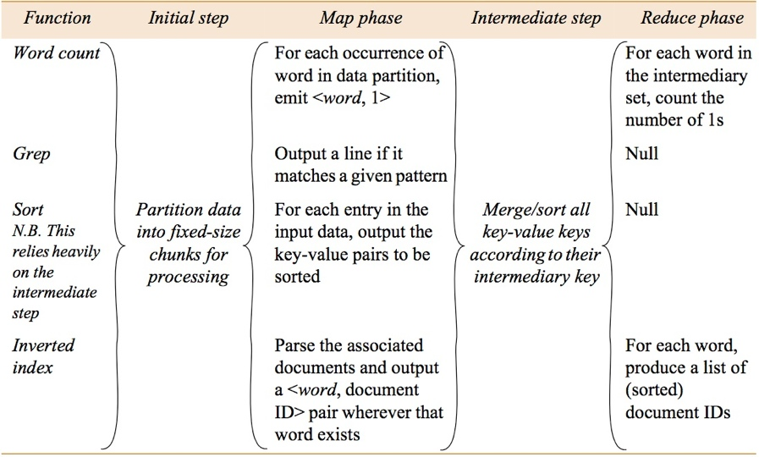
Figure 21.18
Examples of the use of MapReduce
Instructor’s Guide for Coulouris, Dollimore, Kindberg and Blair, Distributed Systems: Concepts and Design Edn. 5
© Pearson Education 2012

Slide 23
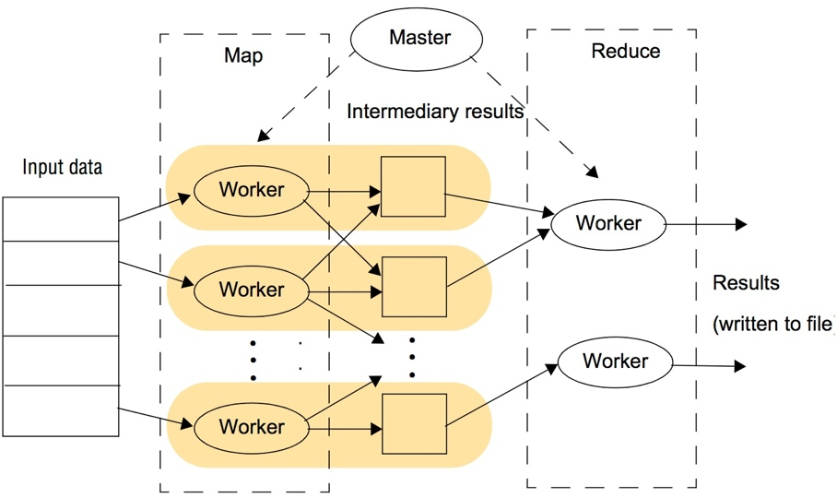
Figure 21.19
The overall execution of a MapReduce program
Instructor’s Guide for Coulouris, Dollimore, Kindberg and Blair, Distributed Systems: Concepts and Design Edn. 5
© Pearson Education 2012

Slide 24
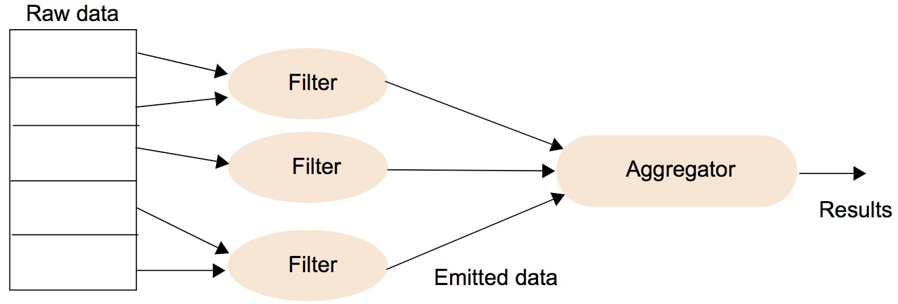
Figure 21.20
The overall execution of a Sawzall program
Instructor’s Guide for Coulouris, Dollimore, Kindberg and Blair, Distributed Systems: Concepts and Design Edn. 5
© Pearson Education 2012

Slide 25
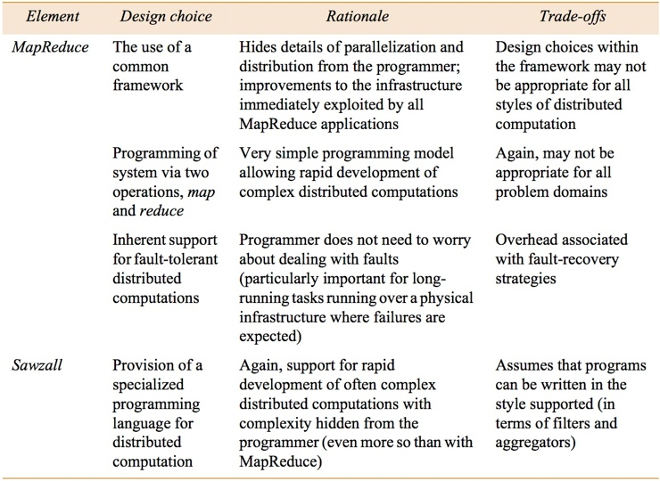
Figure 21.21
Summary of design choices related to distributed computation
Instructor’s Guide for Coulouris, Dollimore, Kindberg and Blair, Distributed Systems: Concepts and Design Edn. 5
© Pearson Education 2012

